Slide 1

Neuroscience Group
Led by Jennifer

Slide 2
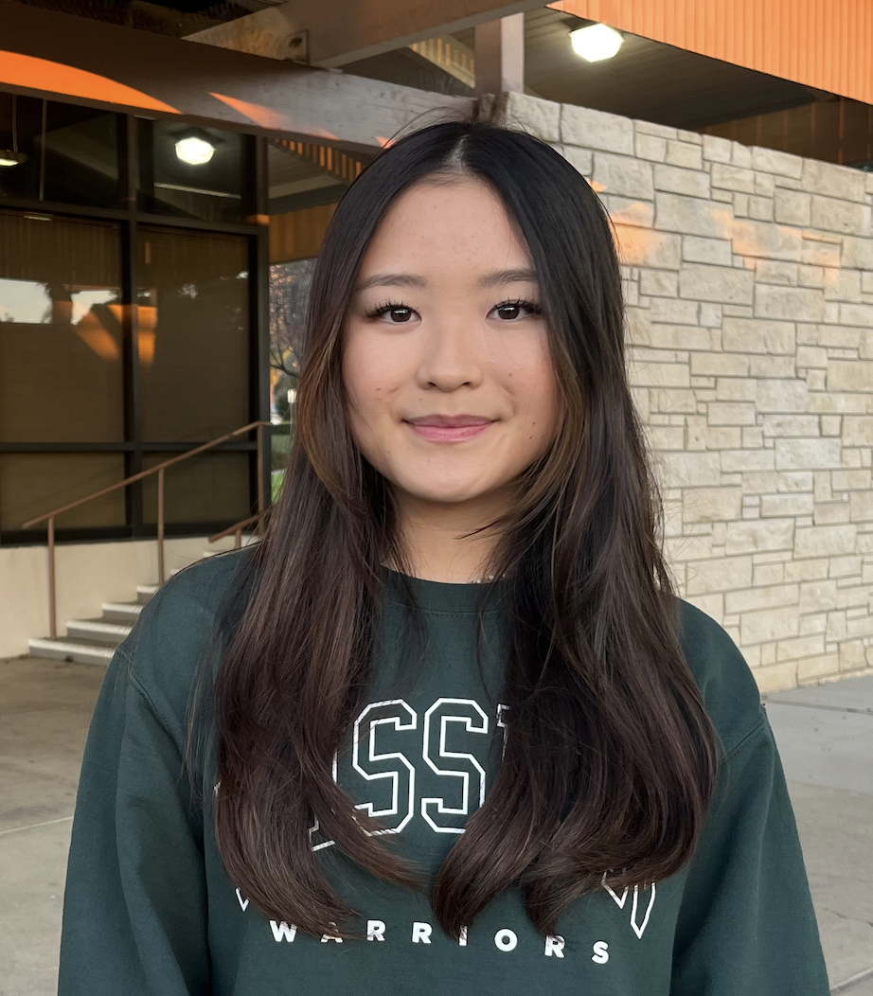
About the Mentor
Hi! My name is Jennifer
Rising senior at MSJHS
2 years: Neuroscience research working with Stanford educated advisor
Leading a research team of younger students
Currently publishing 2 research papers(semantic memory, design thinking)
Presented work at various research conferences
Worked in UPenn’s Neuroscience Lab

Slide 3
What is Neuroscience?
The biological and physiological processes of the brain and nervous system
Focus: cognitive neuroscience & memory

Slide 4
What’s the difference?
Neuroscience | Psychology
The structure or function of the nervous system and brain. How biological processes in the brain give rise to cognitive functions Studies neurons, neurotransmitters, brain circuits, and brain anatomy | Human behavior, mental processes, and the factors that influence them. Studies how we think, learn, feel, and behave Clinical psychology, developmental psychology, and social psychology

Slide 5
Why study neuro?
Flexible field with medical, research, and tech focused career paths
Interdisciplinary field with overlaps with bio, chem, psych, cs, etc.
Learn about what’s really going on in our minds
Rapidly growing field in importance and advancements

Slide 6
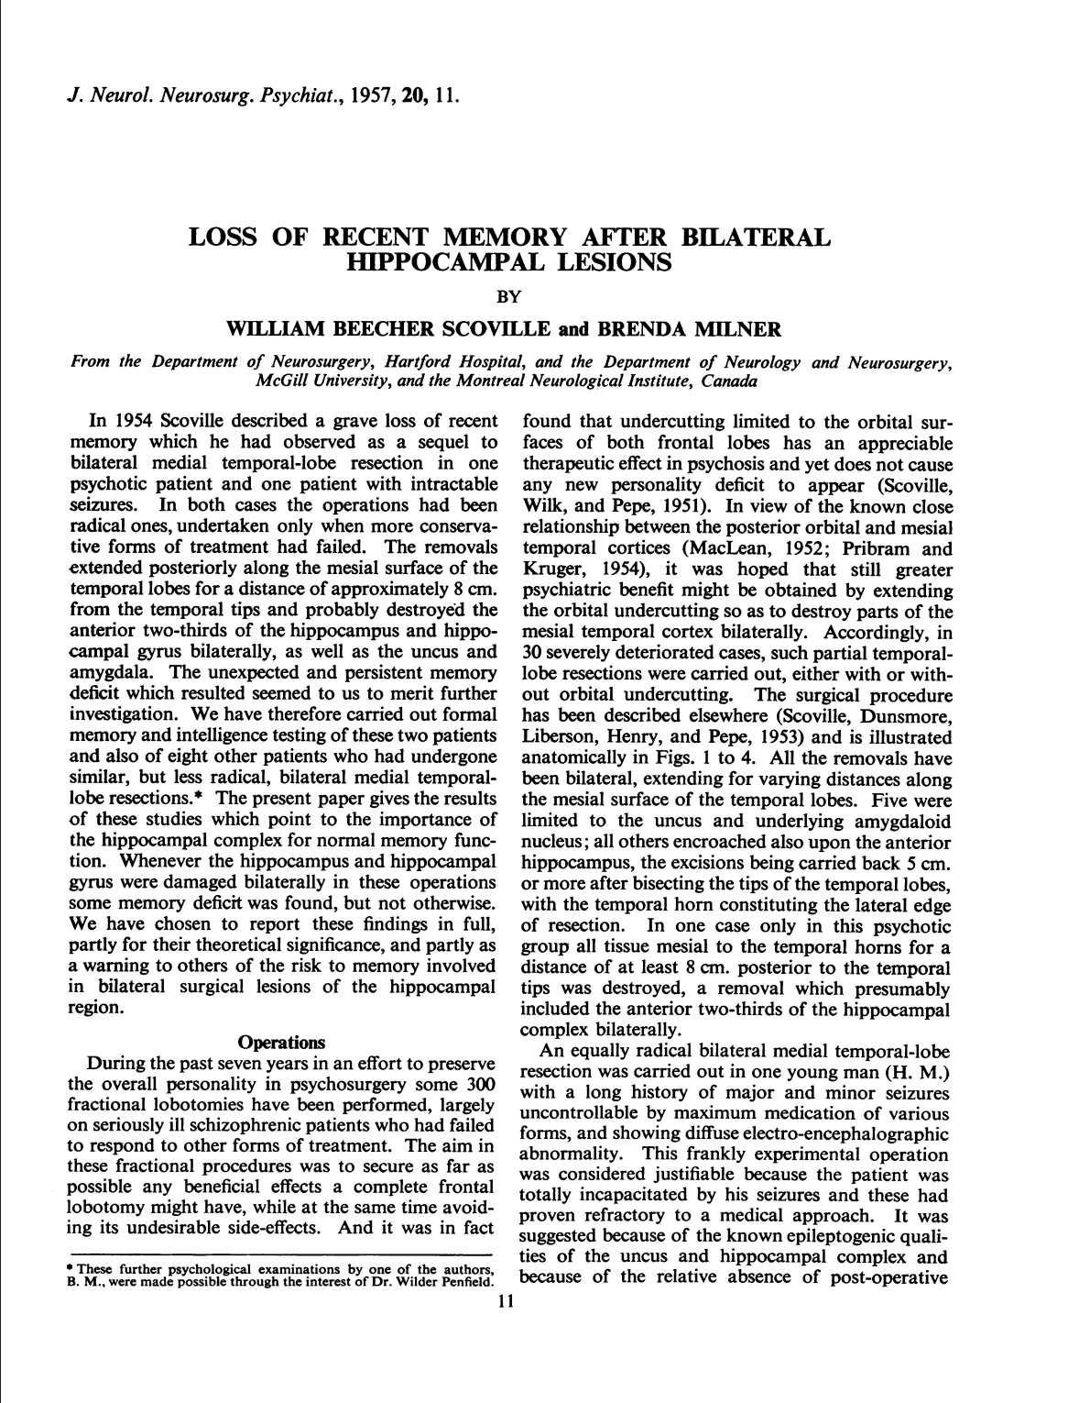
1. Loss of Recent Memory after Bilateral Hippocampal Lesions
Scoville & Milner 1957
Landmark study in neuroscience
Investigated the role of the hippocampus in memory
Amnesia, cognition, memory storage and retrieval
Cornerstone of research on the brain’s functions

Slide 7
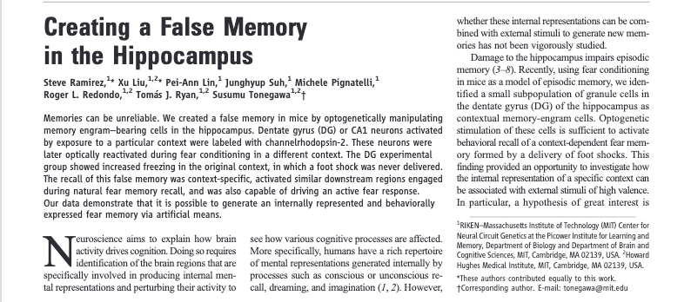
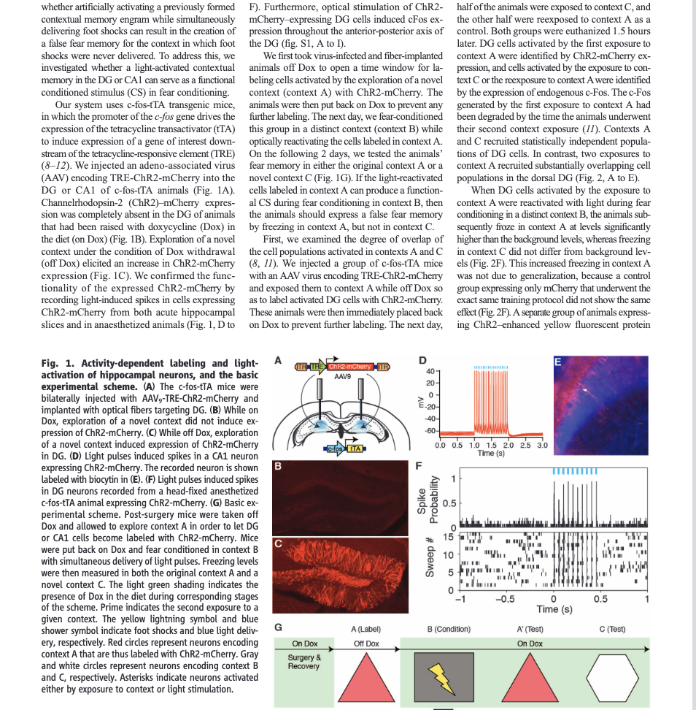
2. Creating a False Memory in the Hippocampus
Ramirez et. al 2013
Optogenetics: using light to control neurons
Artificially generating false memories
Key insights into the neural basis of memory formation & manipulation

Slide 8
Group activities
Memory tests & Games
Experiment drawing task simulations
Mystery Patient Case File
Brain anatomy heads up
Amnesia Chameleon
Neuroethics discussions
More!

Slide 9
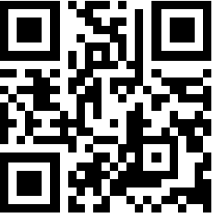
Join Neuro!
Syllabus Link: tinyurl.com/ysjcneuro

